Slide 1
Senso

Slide 2
Flexibility Assessment

Slide 3
Senso Flexibility Test Description
“The Flexibility Test (figural) measures cognitive flexibility and ability of switching between different concepts. This cognitive flexibility declines with age and often leads to an inability to adapt to new situations and environments. However, individuals presenting symptoms of mild cognitive impairment often present increased impairment of cognitive flexibility. Through the accurate measurement of both reaction times and accuracy, the flexibility test can therefore generate relevant information from a clinical point of view.”

Slide 4
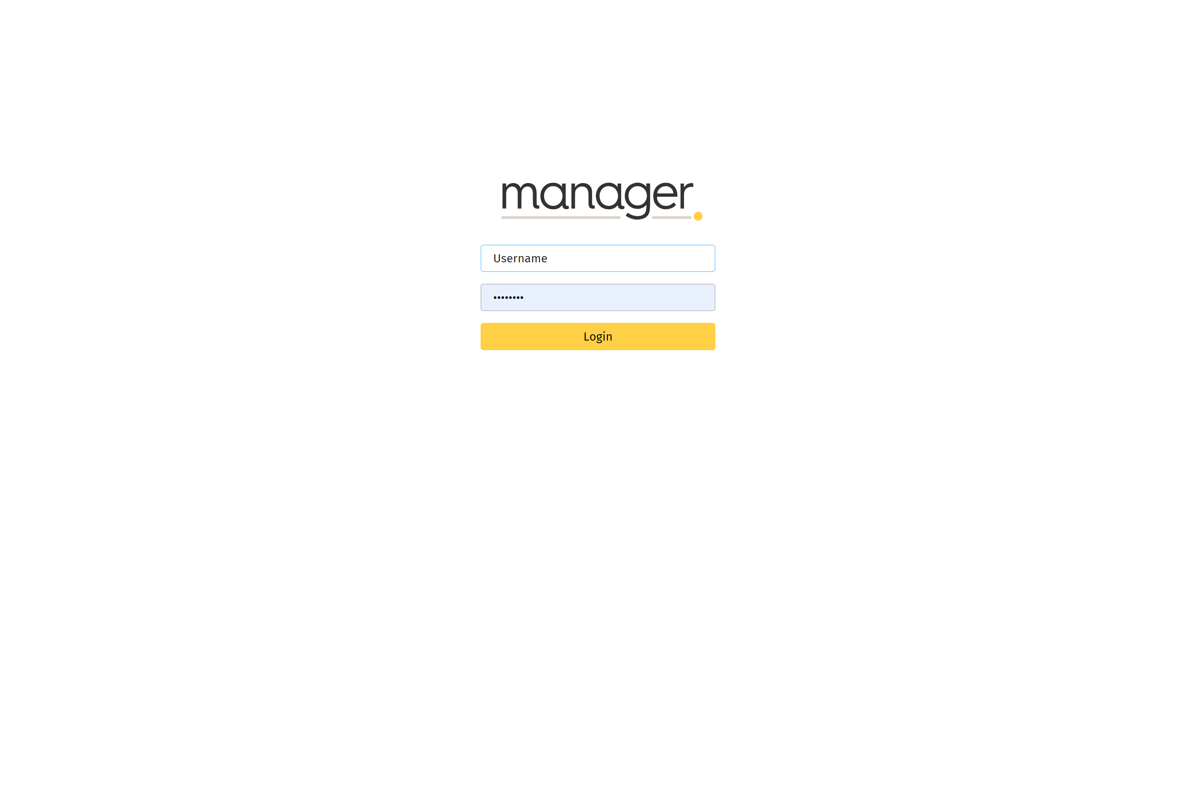
Senso Flexibility Test Login
To start the Flexibility Test, first log into Senso Manager (https://manager.dividat.com/login), preferably on a tablet/computer near the Senso Play platform.
Enter your username and password.
If you have problems finding your login, contact HUR USA or email service@hurusa.com.

Slide 5
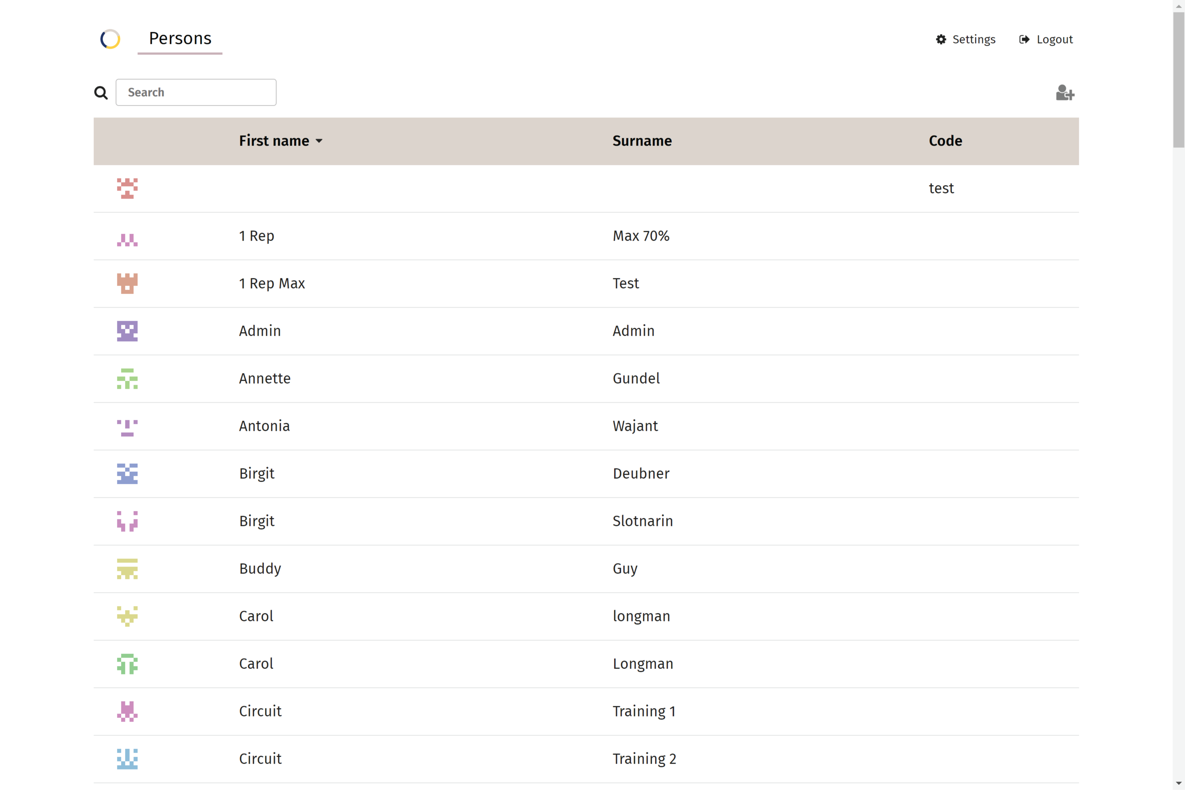
Senso Flexibility Test Choose Client
Select the client you want to perform the Assessment.

Slide 6
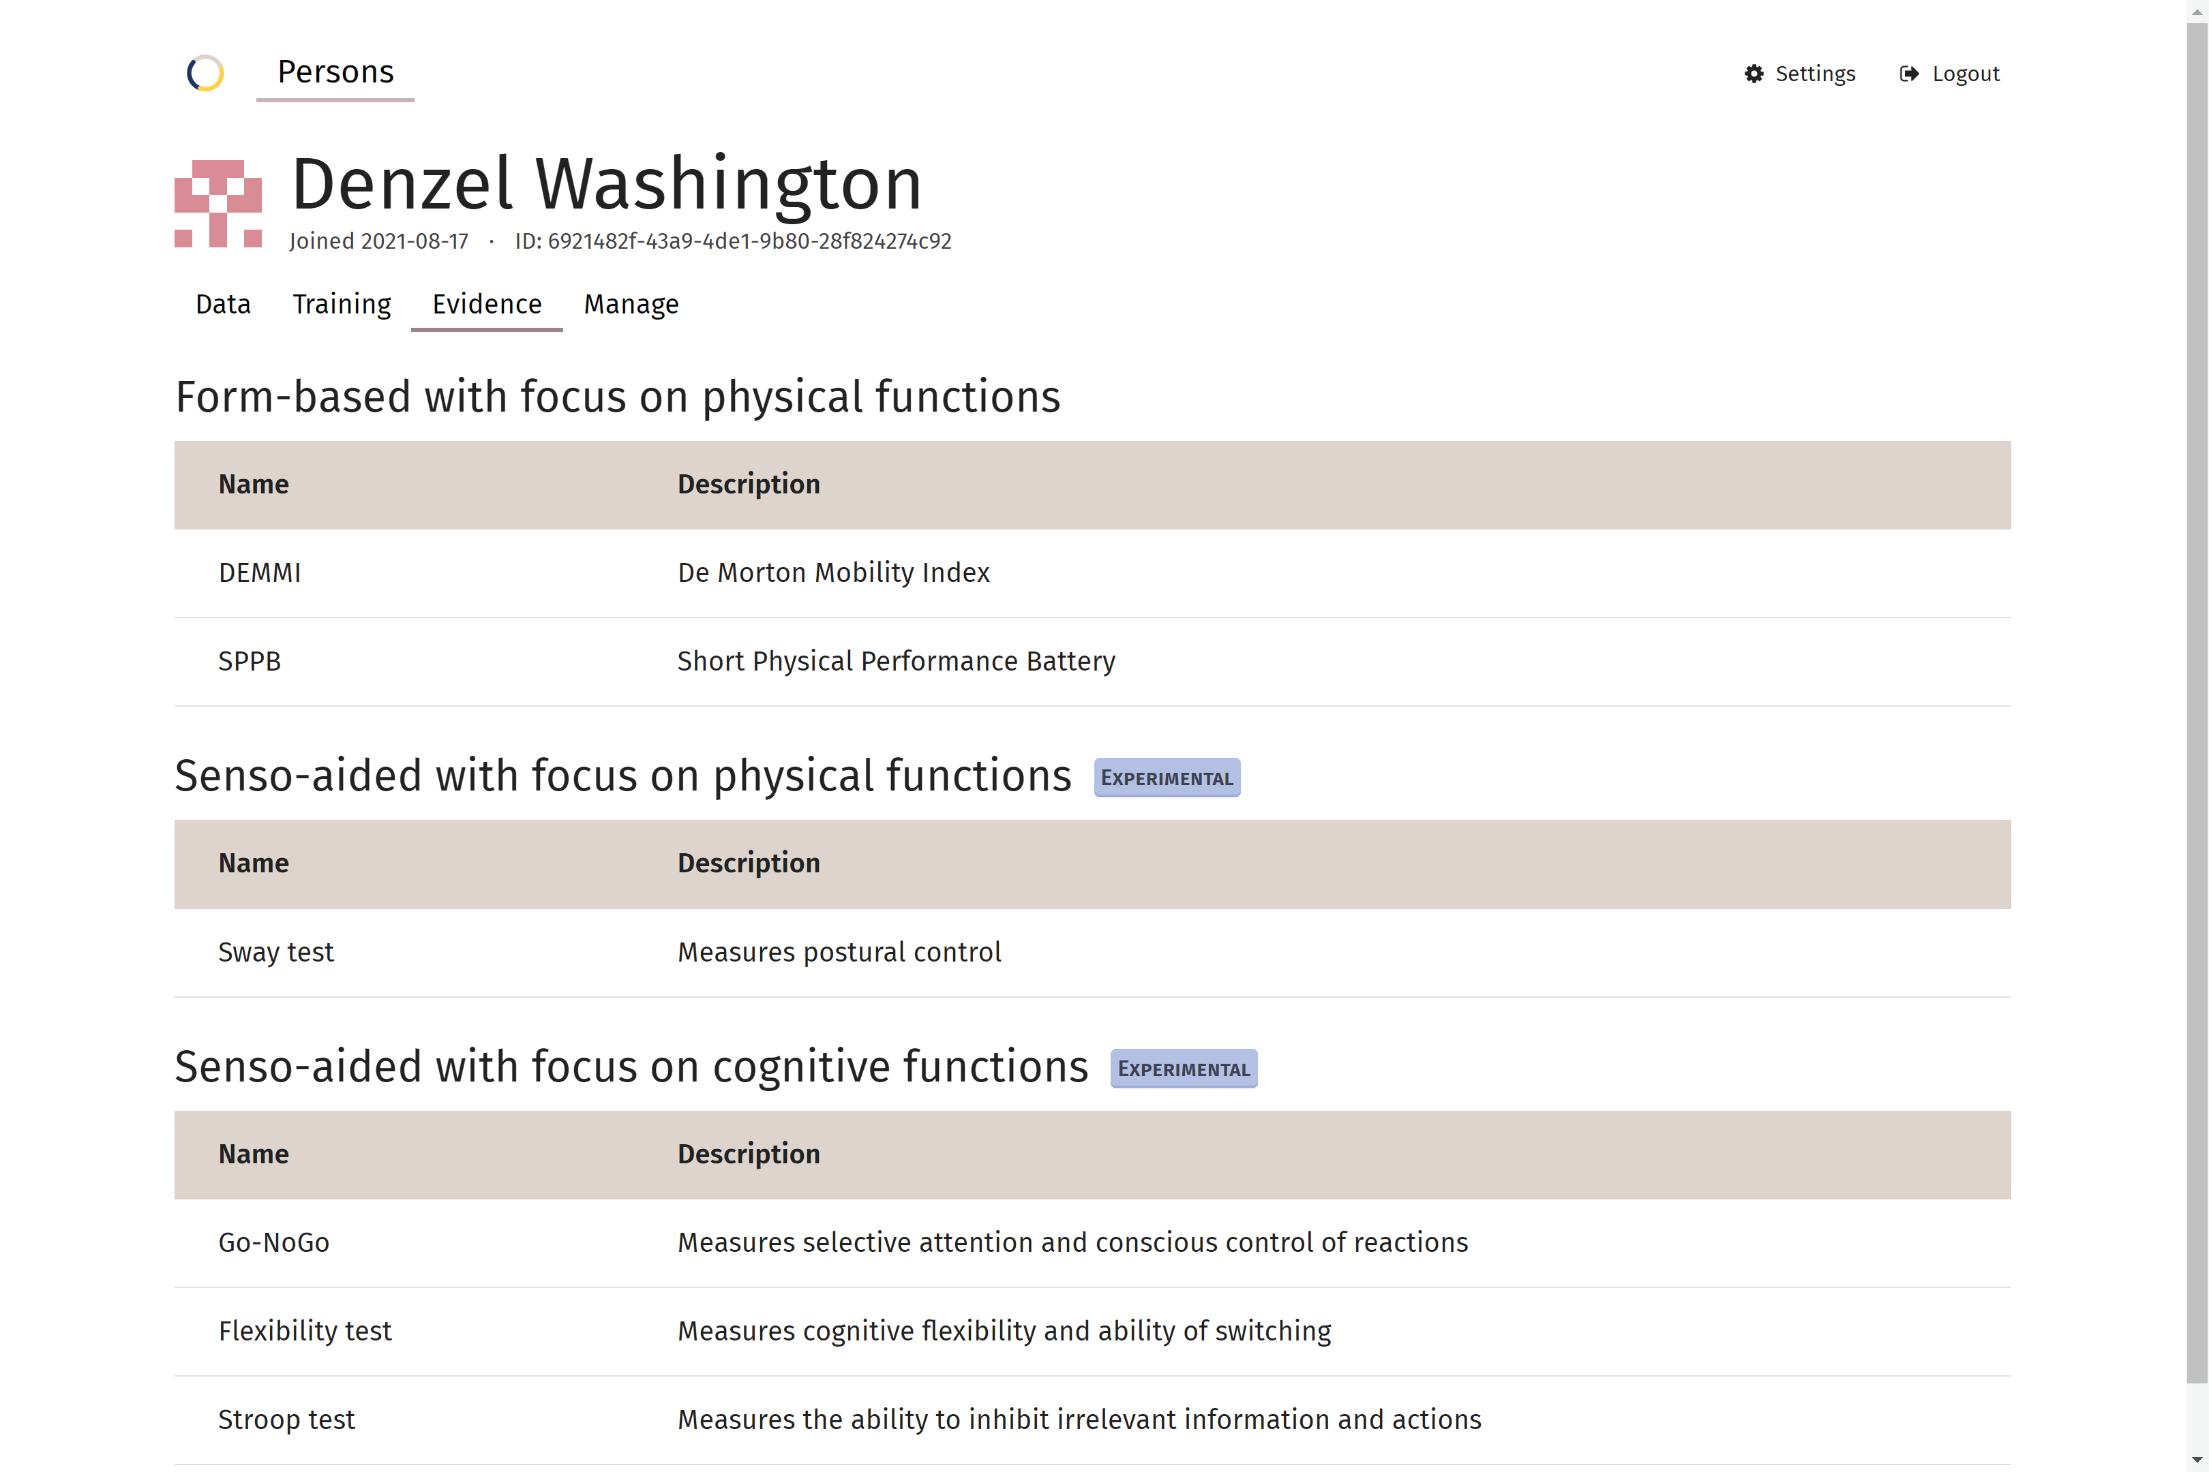
Senso Flexibility Test Choose Assessment
Under the Evidence tab in the client’s profile, you will see a list of Assessments.
Select the one you wish the client to perform, in this case the “Flexibility Test.”

Slide 7
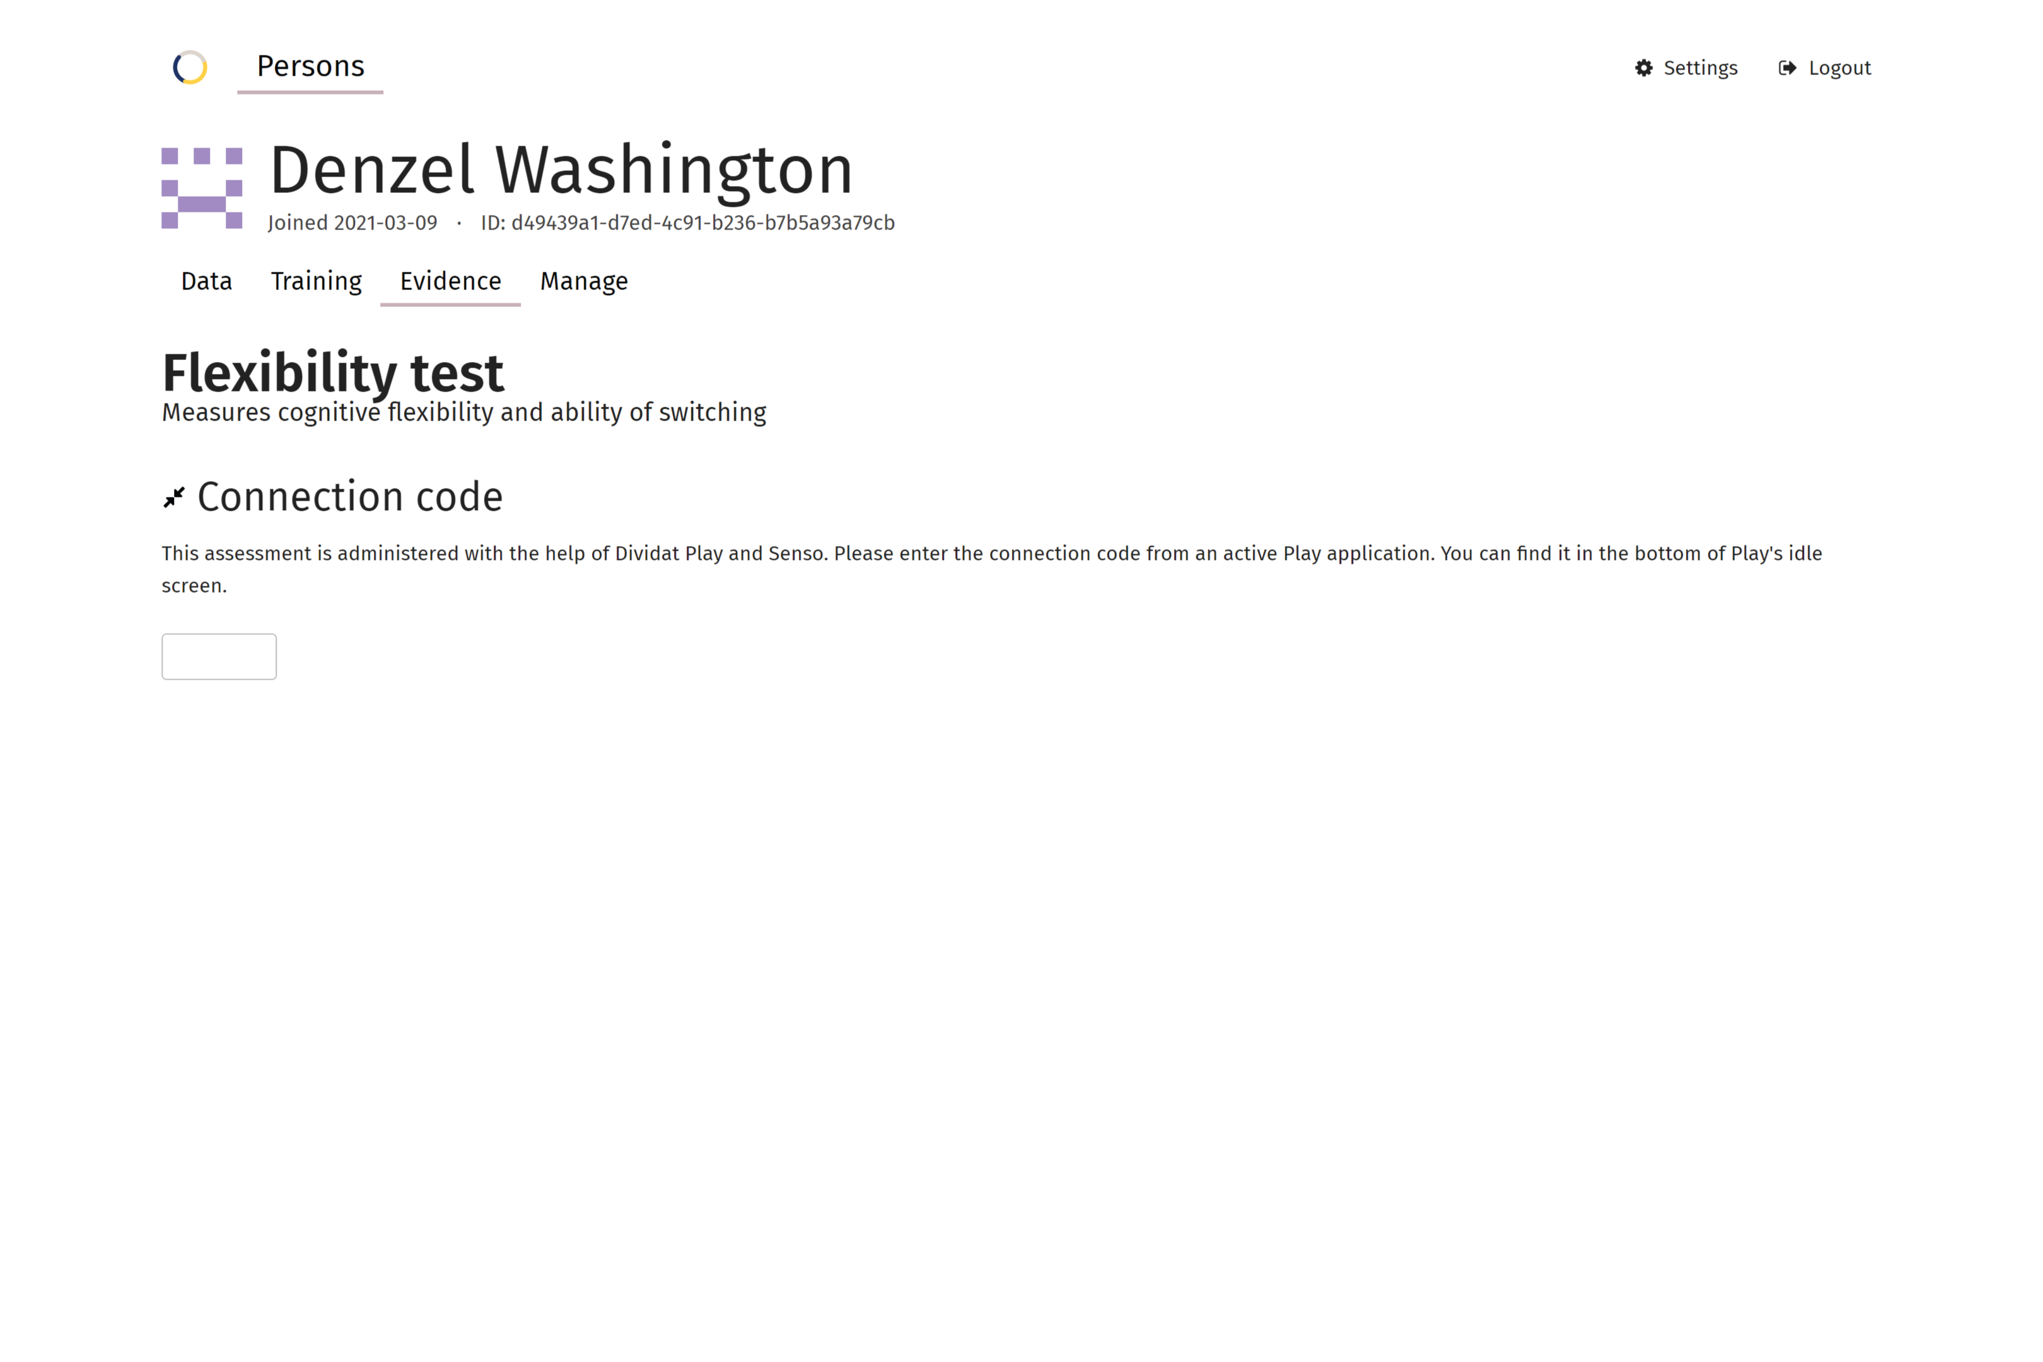
Senso Flexibility Test Connection Code
Once you have selected the assessment to perform, you are asked to enter a “Connection Code.”

Slide 8
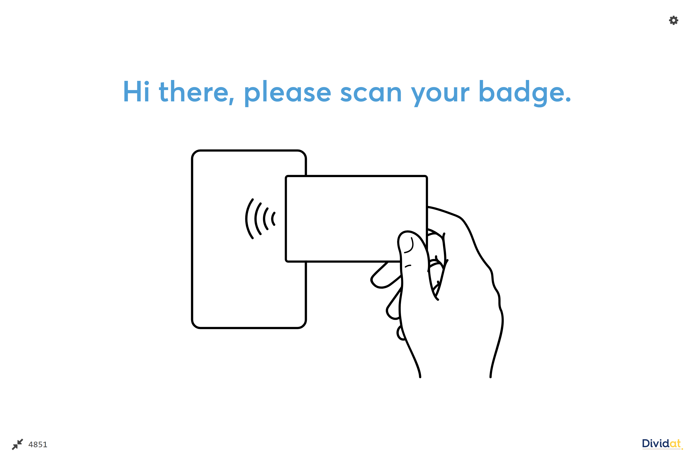
Senso Flexibility Test Connection Code
The 4-digit Connection Code is found at the bottom of the Senso Play TV monitor.
A new code is generated after each Assessment.

Slide 9
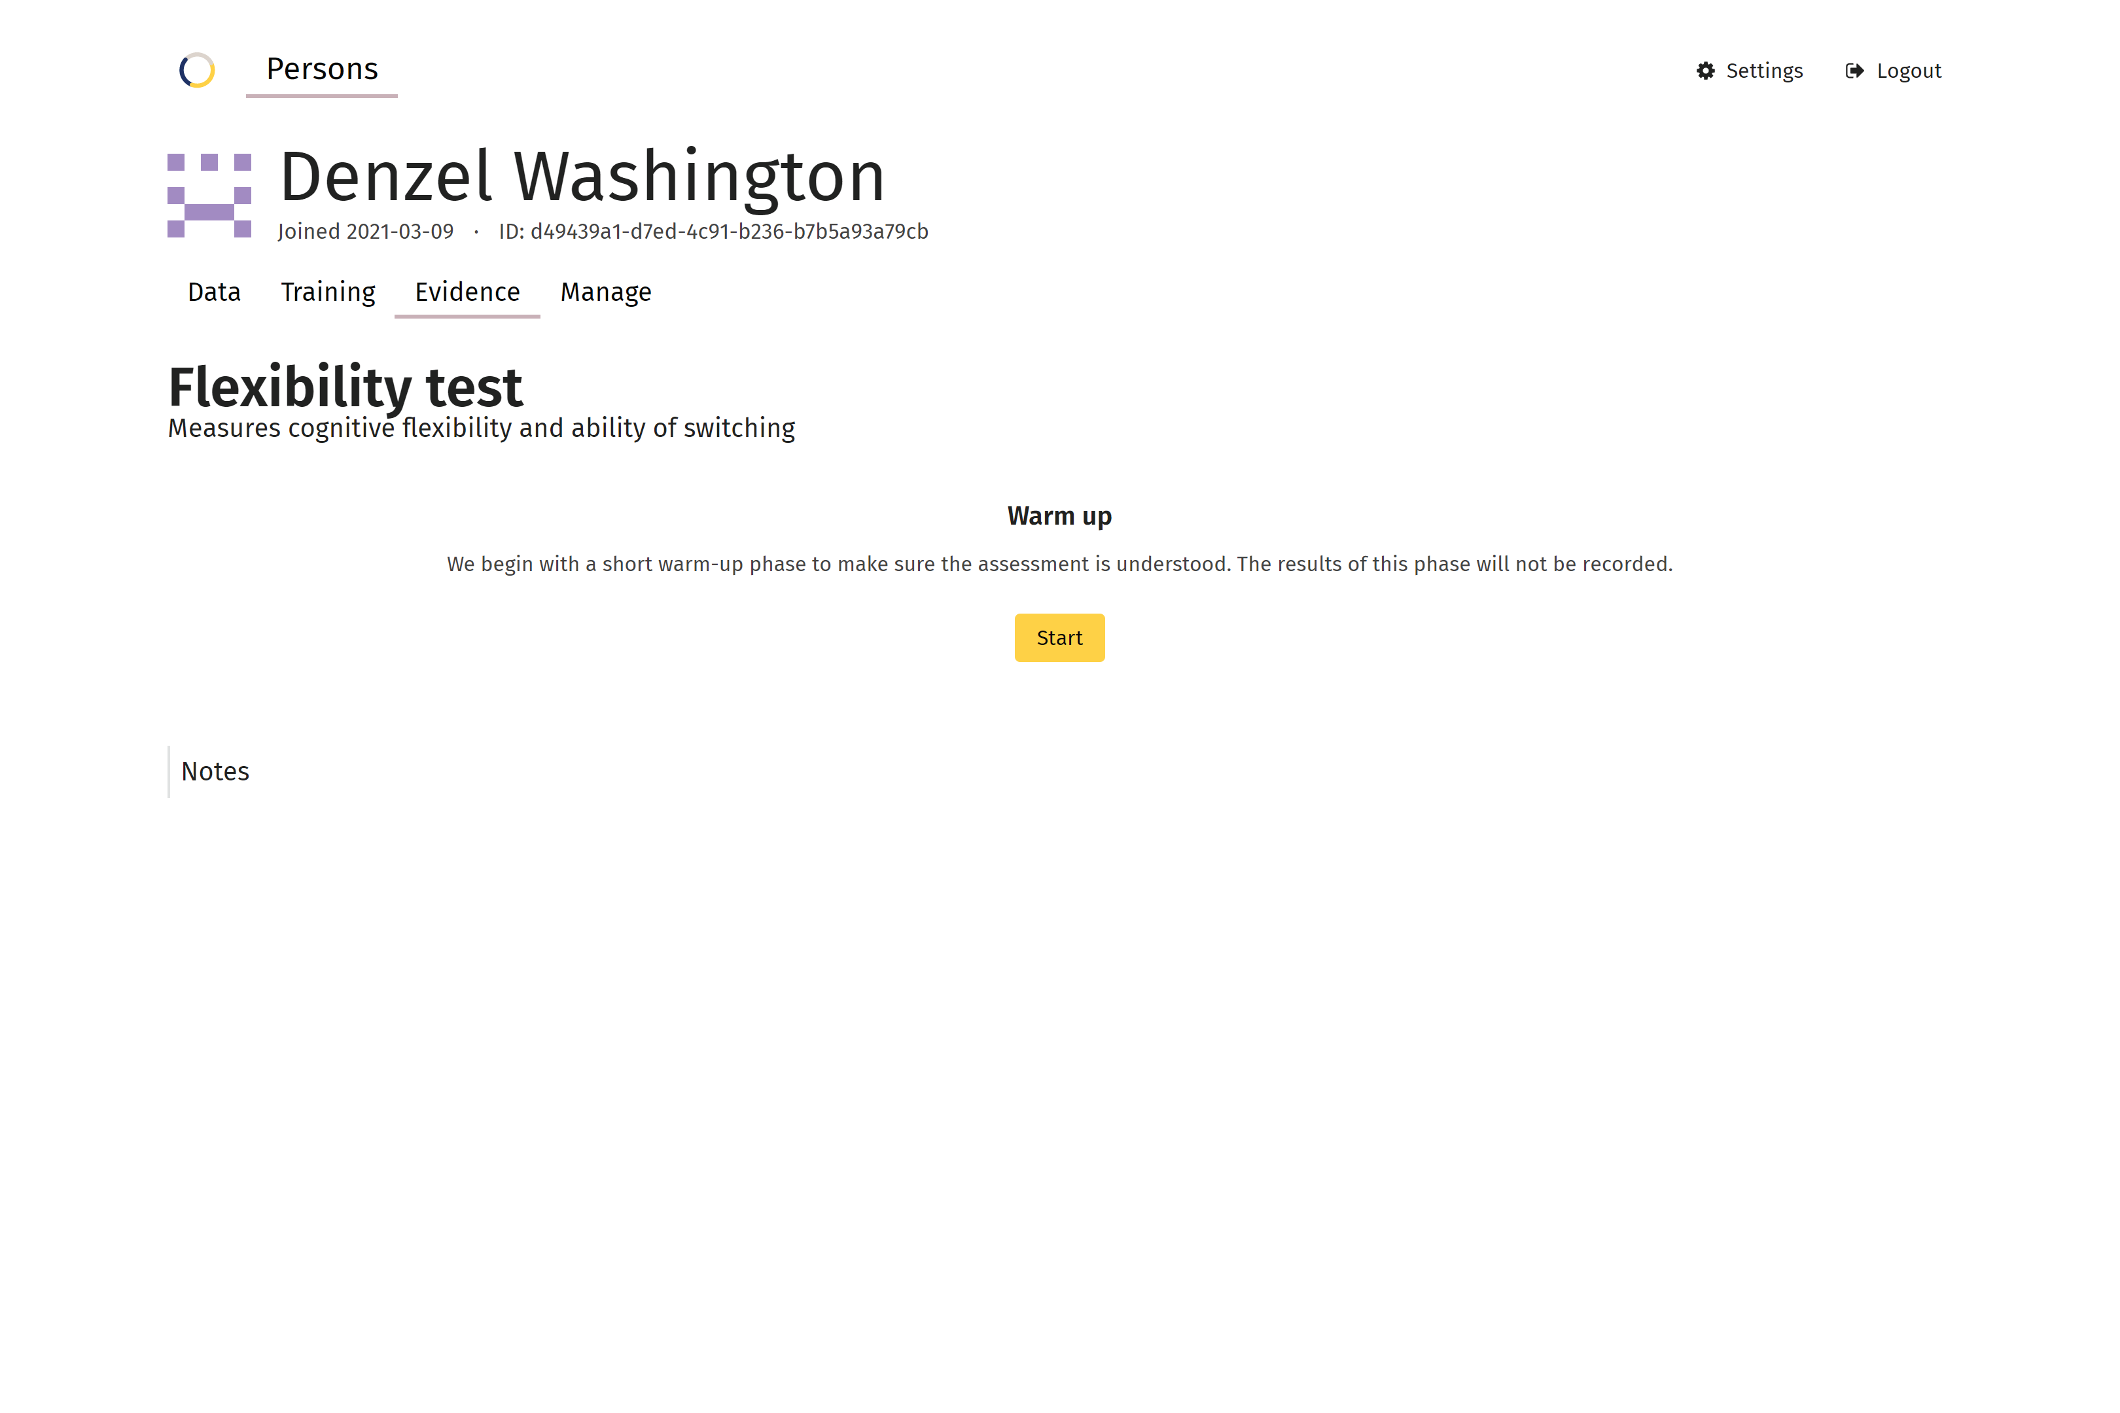
Senso Flexibility Test Warm-Up
After you enter the 4-digit code, your tablet/computer will prompt you to Start the “Warm-Up.”
Flexibility starts with a warm-up to make sure the client understands how to perform the test (the Warm-Up phase is not recorded).
When the client is ready, you will click the “Start” button.
You can also add notes if needed.

Slide 10
Senso Flexibility Test Warm Up
Simultaneously, the Senso Play TV monitor displays the directions for the Warm Up (as indicated in the upper left corner):
Start with both feet on the center plate.
Look at the small gray dot at the center of the screen. Rounded and angular figures will appear to its sides. Respond by alternating between stepping towards the rounded and angular figure.
First the rounded figure, then the angular figure, then the rounded figure, and so on.
If you make a mistake, the correct answer will be displayed.
*At any time, the Assessment can be ended by selecting the “Abort Assessment” button in the upper right of the monitor.

Slide 11
Senso Flexibility Test Warm Up
After you click “Start” on the tablet/computer, the Warm-Up will begin.
During the Warm-Up (but not the Assessment), you will hear audio cues that indicate correct/incorrect responses.
At the bottom of the screen, you will see a green status bar that indicates how much time is left.
*The Warm-Up is approximately one minute long.

Slide 12
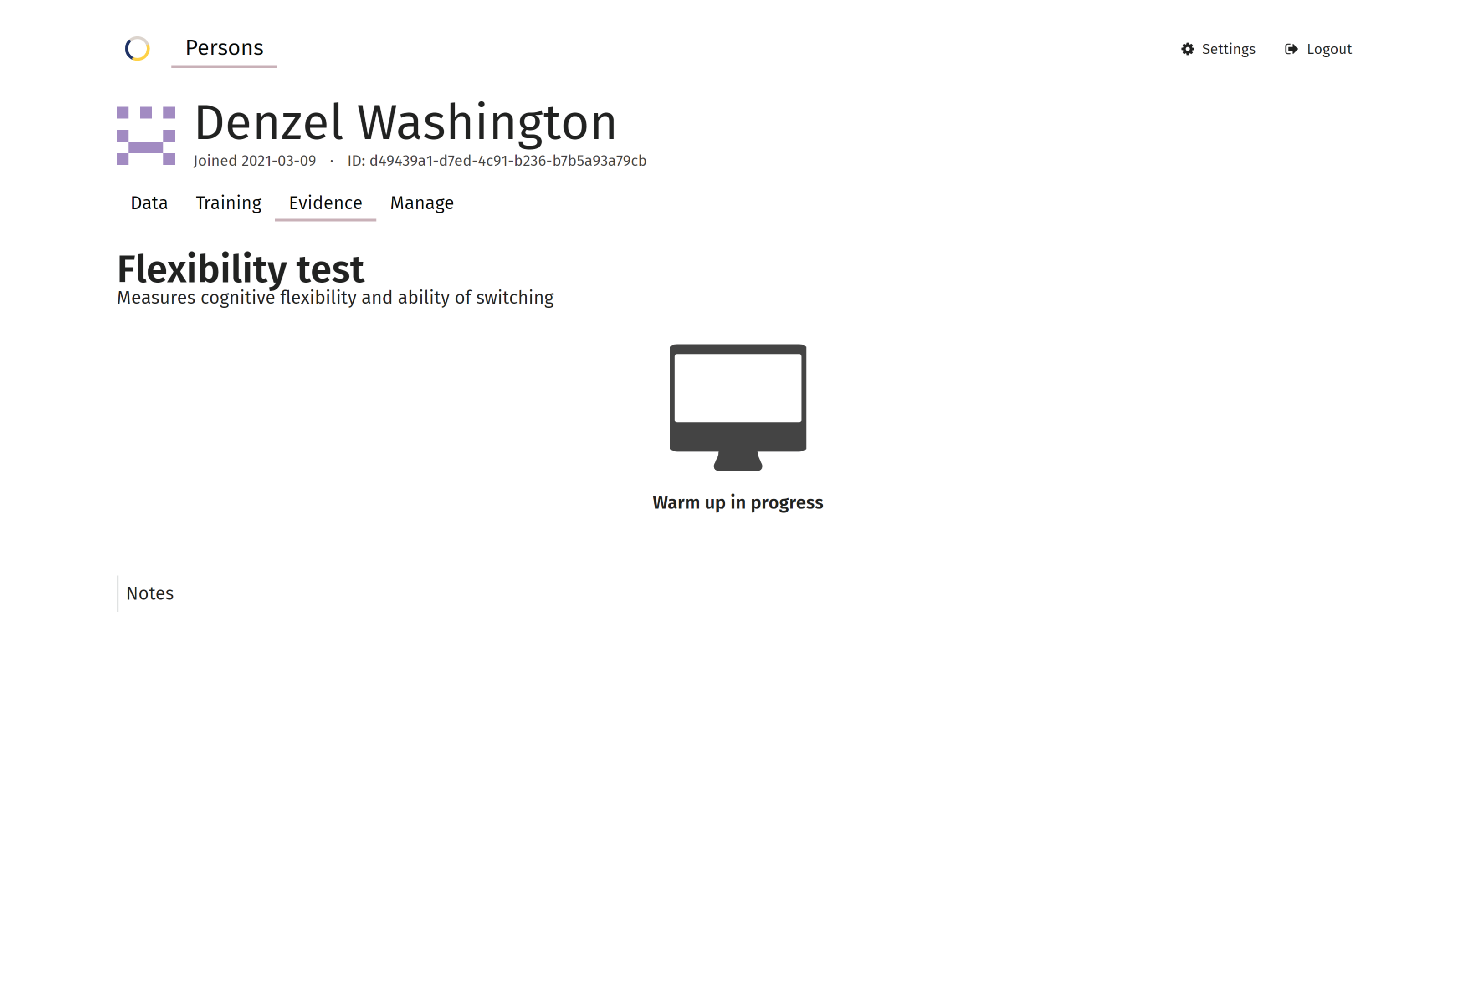
Senso Flexibility Test Warm Up
While the Warm-Up is running, the tablet/computer screen will indicate that the Warm-Up is in progress.

Slide 13
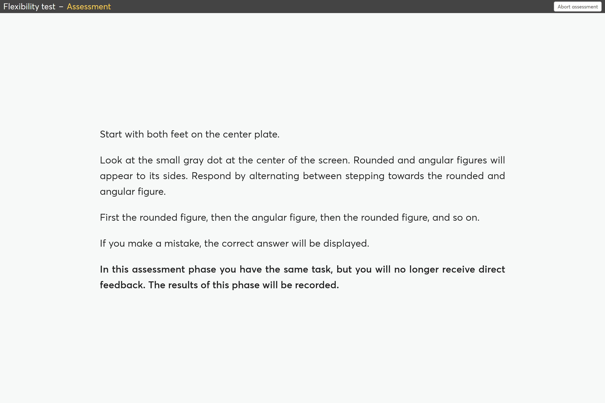
Senso Flexibility Test Assessment
When the Warm-Up has ended, the client will see the SAME instructions before the actual Assessment (as indicated in the upper left corner).

Slide 14
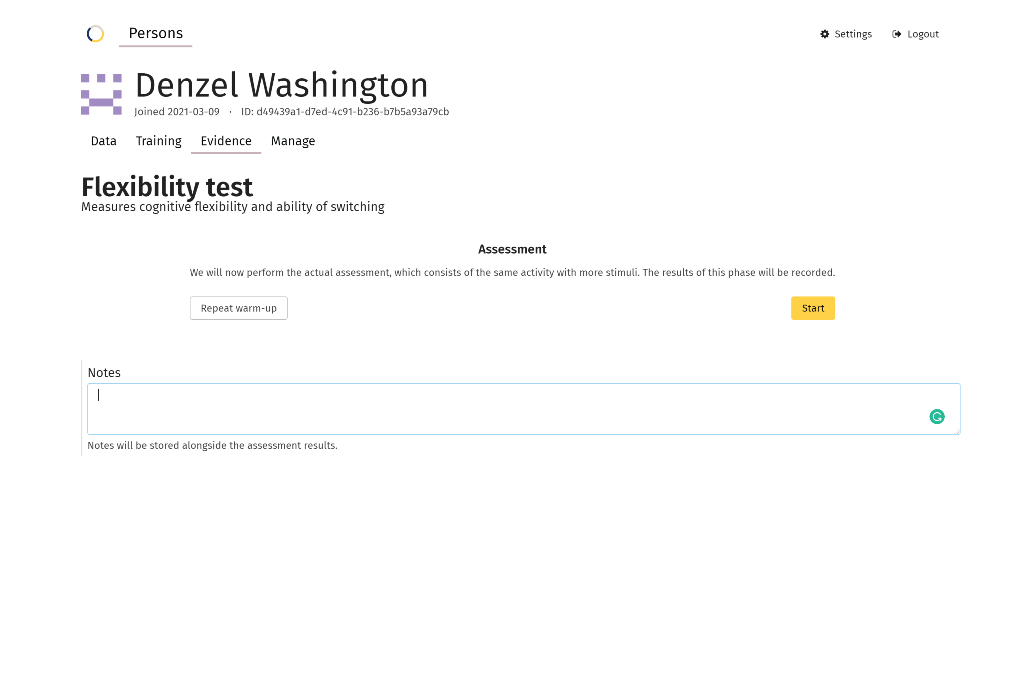
Senso Flexibility Test Assessment
After the initial warm-up, you can begin the Assessment by clicking the “Start” button.
However, you can have the client do the Warm-Up again by selecting, “Repeat Warm-Up.”

Slide 15
Senso Flexibility Test Assessment
Again, the same instructions apply to the actual Assessment, and the green status bar will indicate the amount to time remaining.
*The Assessment is approximately two minutes long.

Slide 16
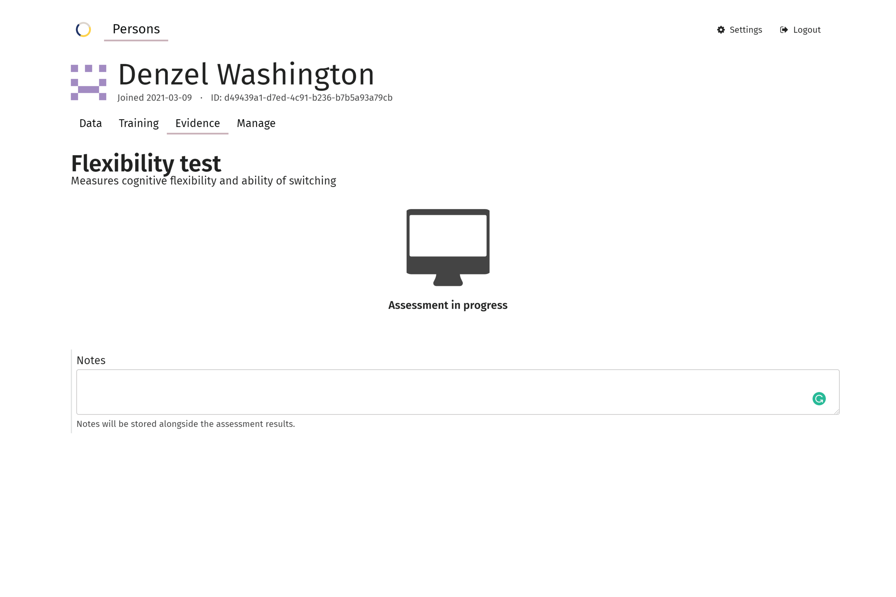
Senso Flexibility Test Assessment
While the Assessment is running, the tablet/computer screen will indicate that the Assessment is in progress.

Slide 17
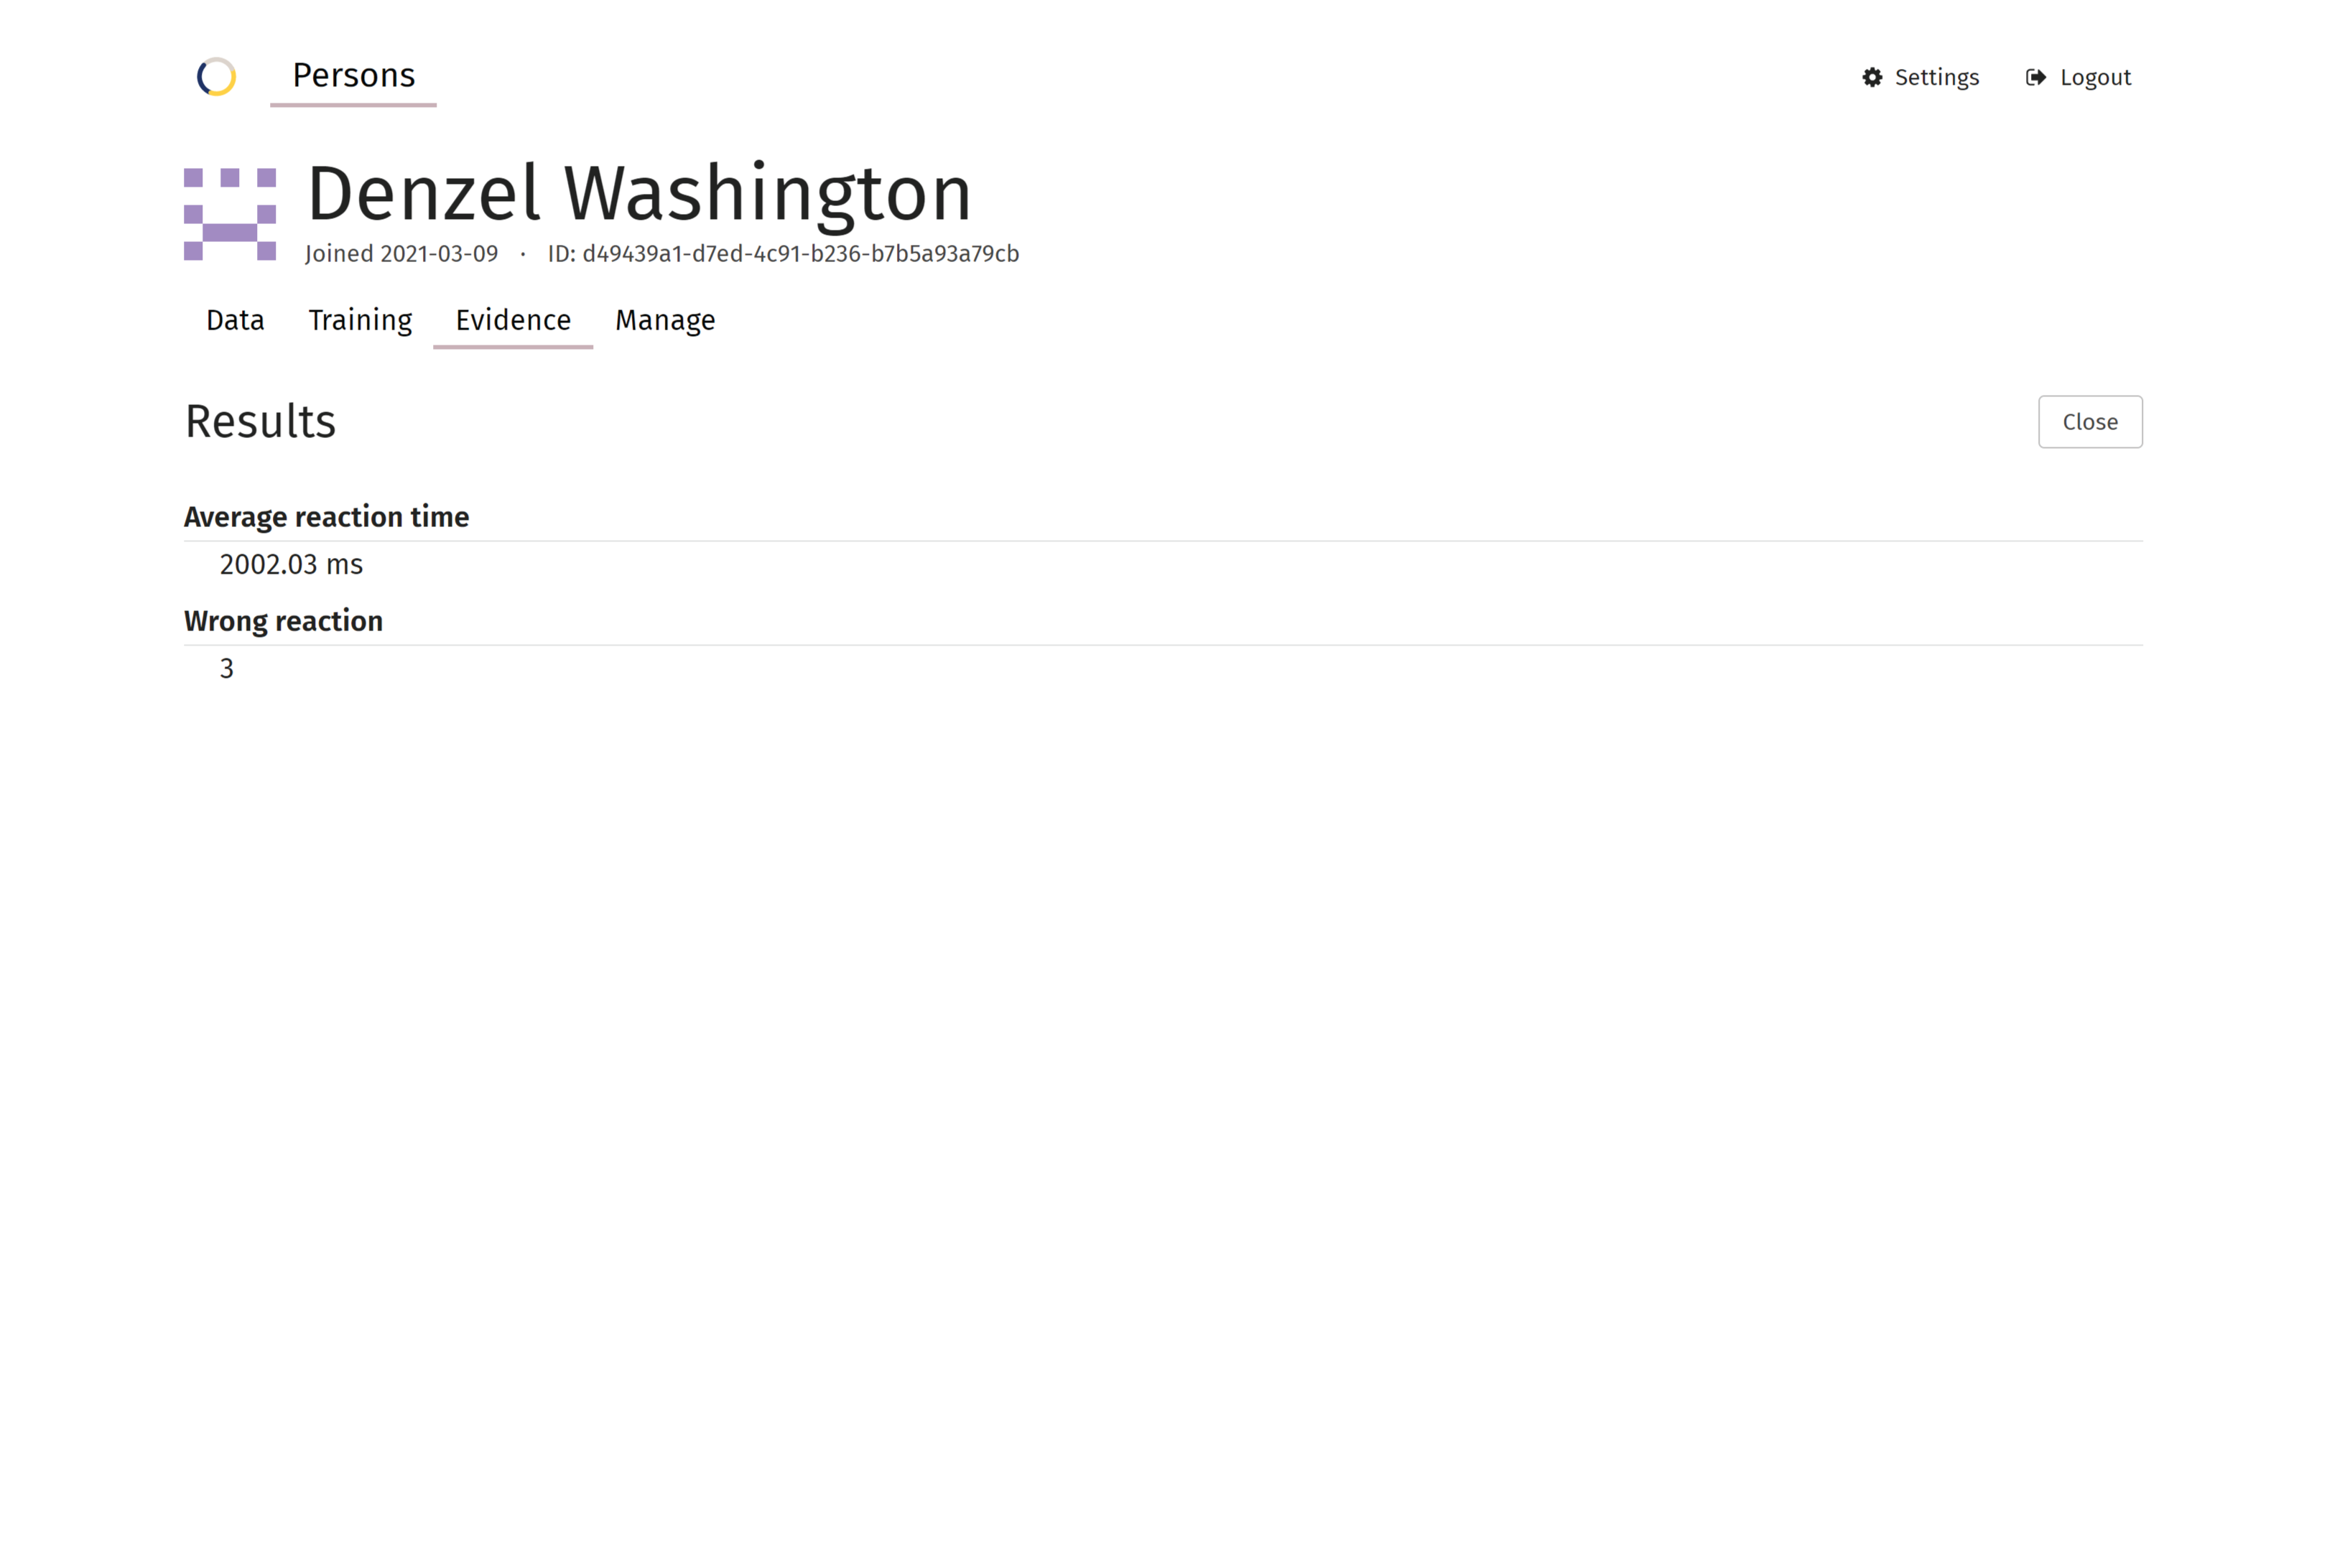
Senso Flexibility Test Assessment Results
When the Flexibility Test is complete, the results are displayed on the tablet/computer.
Here, you will see the measurements taken: Average Reaction Time and number of Wrong Reactions.
Measurements

Slide 18
Senso Flexibility Test Analysis
The results can be viewed and compared to previous tests by going to the client’s Data tab, and selecting “View Analysis” next to the desired Assessment.

Slide 19
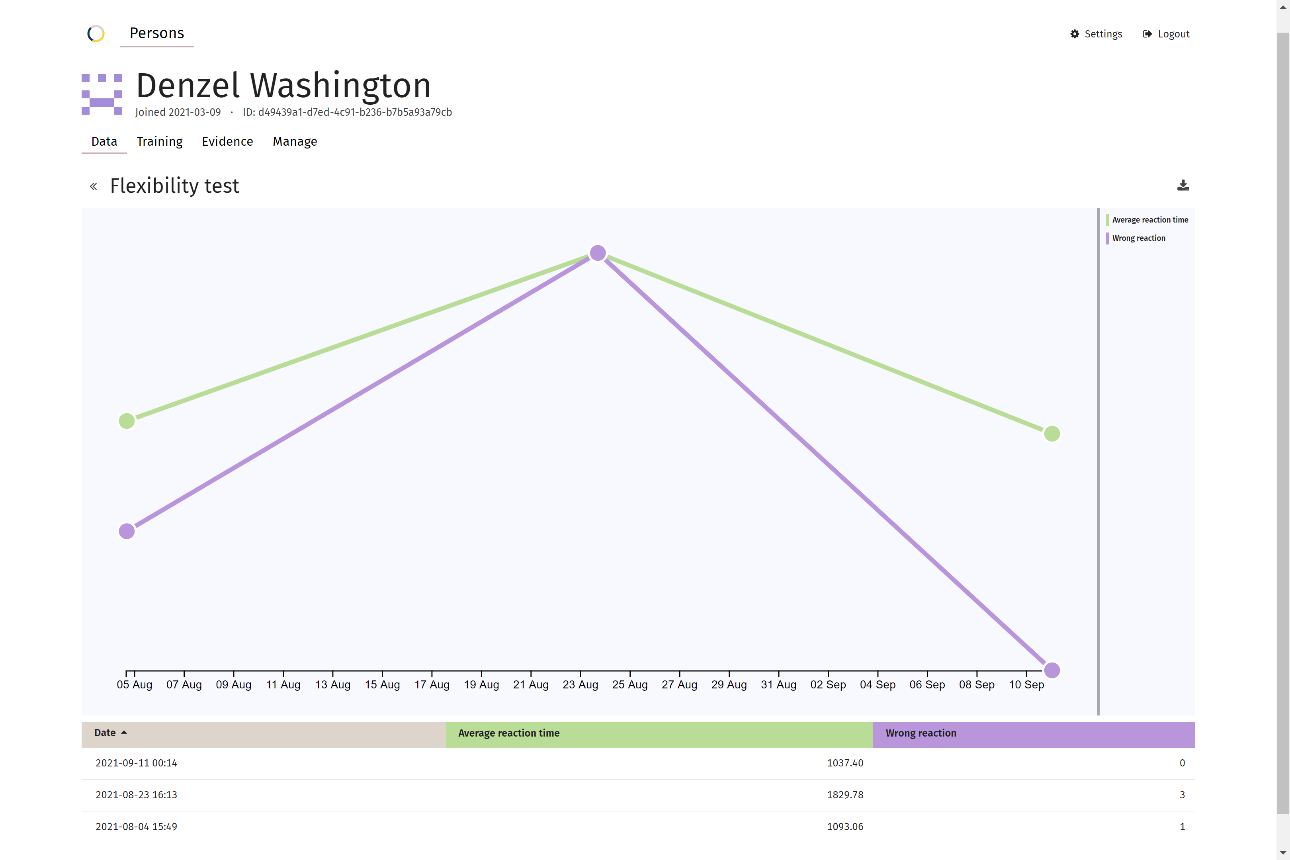
Senso Flexibility Test Assessment Results
Here, you can compare previous Assessment results in both numerical and graph form.

Slide 20
Thank you

